Slide 1
Data Flow Diagrams
Mechanics

Slide 2


Outline
DFD symbols
  External entities (sources and sinks)
  Data Stores
  Data Flows
  Processes
Types of diagrams
Step by step approach
Rules

Slide 3
Some Rules for External Entities
External people, systems and data stores
Reside outside the system, but interact with system
Either a) receive info from system, b) trigger system into motion, or c) provide new information to system
e.g. Customers, managers
Not clerks or other staff who simply move data
External
Entities

Slide 4
Some Rules for Data Stores
Internal to the system
Data at rest
Include in system if the system processes transform the data
  Store, Add, Delete, Update
Every data store on DFD should correspond to an entity on an ERD
Data stores can come in many forms:
  Hanging file folders
  Computer-based files
  Notebooks
D1
Data Stores

Slide 5


Some Rules for Data Flows
Data in motion, moving from one place to another in the system
  From external entity (source) to system
  From system to external entity (sink)
  From internal symbol to internal symbol, but always either start or end at a process
Data Flow

Slide 6
Some Rules for Processes
Always internal to system
Law of conservation of data:
#1: Data stays at rest unless
moved by a process.
#2: Processes cannot consume or create data
  Must have at least 1 input data flow (to avoid miracles)
  Must have at least 1 output data flow (to avoid black holes)
  Should have sufficient inputs to create outputs (to avoid gray holes)
0.
Processes
Notes:
Always internal: we do not model what external entities or systems do with the data (they are a “black box” as far as we are concerned).
#1: Processes may PULL or PUSH data.
#2: Processes cannot consume or create data BY THEMSELVES. The system may provide processes information to add or delete data (within data stores), but processes cannot simply eat or invent data. Note the system would have to be TRIGGERED somehow to add or delete data.

Slide 7
Processes
Logical process models omit any processes that do nothing more than move or route data, thus leaving the data unchanged. Valid processes include those that:
  Perform computations (e.g., calculate grade point average)
  Make decisions (determine availability of ordered products)
  Sort, filter or otherwise summarize data (identify overdue invoices)
  Organize data into useful information (e.g., generate a report or answer a question)
  Trigger other processes (e.g., turn on the furnace or instruct a robot)
  Use stored data (create, read, update or delete a record)

Slide 8
Types of Diagrams
Context Diagram
  A data flow diagram (DFD) of the scope of an organizational system that shows the system boundaries, external entities that interact with the system and the major information flows between the entities and the system
Level-O Diagram
  A data flow diagram (DFD) that represents a system’s major processes, data flows and data stores at a high level of detail

Slide 9
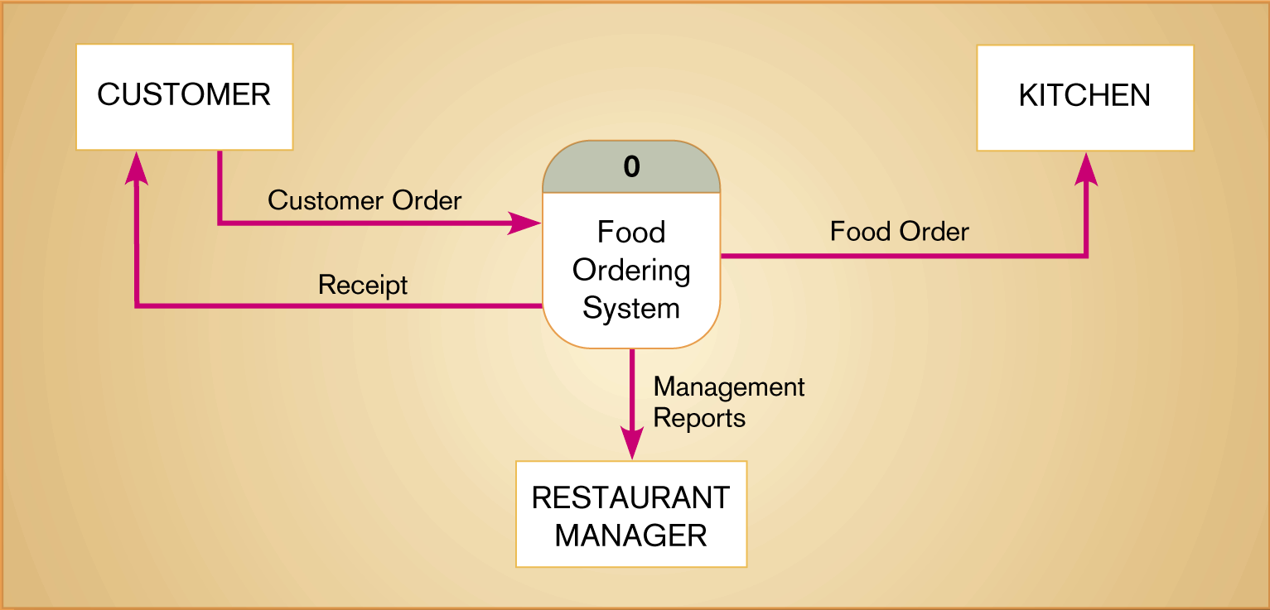
Figure 8-4
Context diagram of Hoosier Burger’s Food ordering system
8.<number>

Slide 10
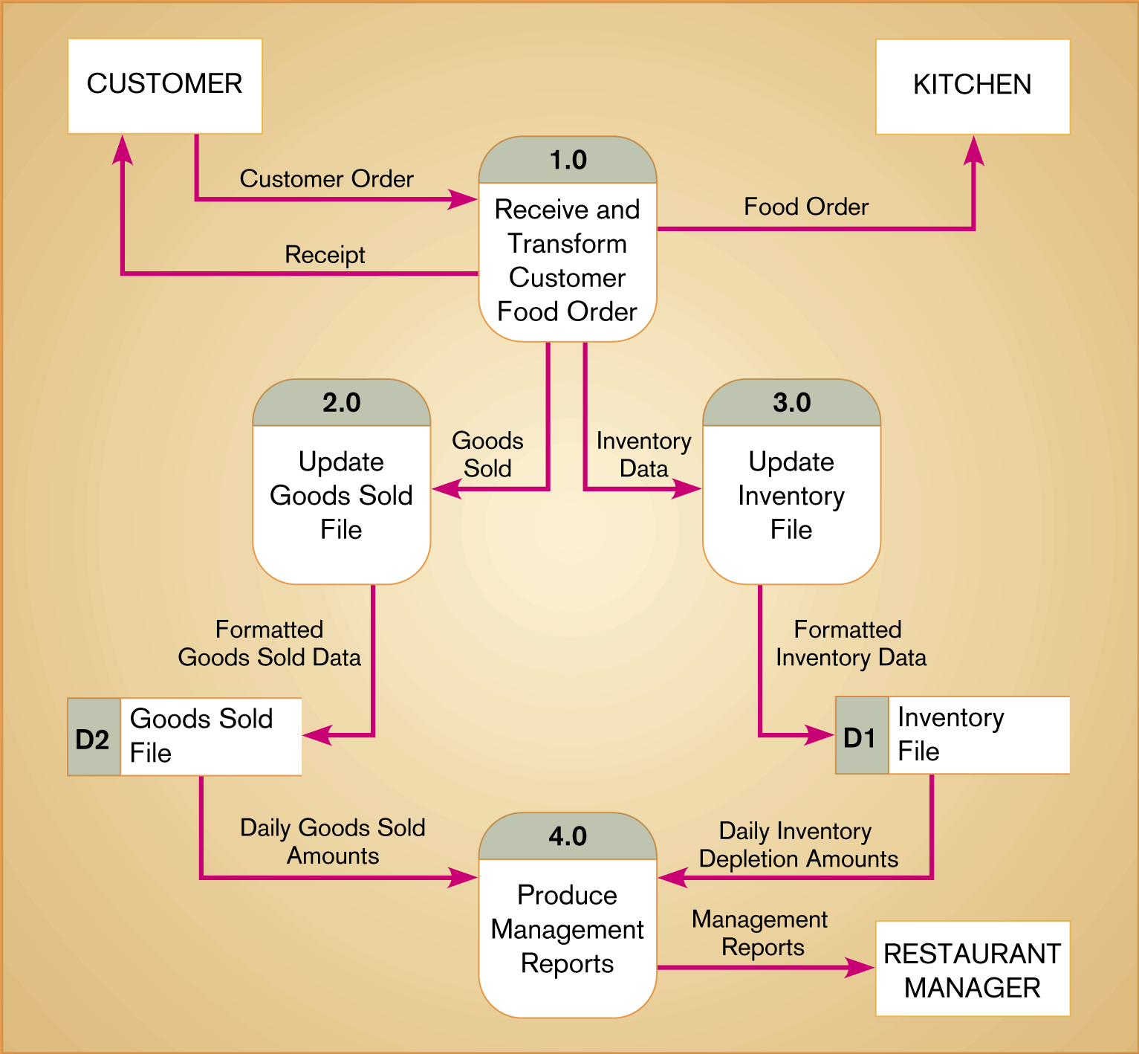
Figure 8-5
Level-0 DFD of Hoosier Burger’s food ordering system
8.<number>

Slide 11
Creating Data Flow Diagrams
Creating DFDs is a highly iterative process of gradual refinement.
General steps:
1. Create a preliminary Context Diagram
2. Identify Use Cases, i.e. the ways in which users most commonly use the system
3. Create DFD fragments for each use case
4. Create a Level 0 diagram from fragments
5. Decompose to Level 1,2,…
6. Go to step 1 and revise as necessary
7. Validate DFDs with users.

Slide 12
Data Flow Diagramming Rules
General
Specific rules to
  Symbols
  Context Diagram
  Level 0 and lower decompositions
  Balancing across levels

Slide 13
DFD Rules—General
Basic rules that apply to all DFDs
  Inputs to a process are always different than outputs
  Objects always have a unique name
    In order to keep the diagram uncluttered, you can repeat data stores and sources/sinks on a diagram
8.<number>

Slide 14
DFD Rules—Symbols (Table 8-2)
Process
  No process can have only outputs (a miracle)
  No process can have only inputs (black hole)
  A process has a verb phrase label
Data Store
  Data cannot be moved directly from one store to another
  Data cannot move directly from an outside source to a data store
  Data cannot move directly from a data store to a data sink
  Data store has a noun phrase label
8.<number>

Slide 15
DFD Rules—Symbols (Table 8-2)
Source/Sink
  Data cannot move directly from a source to a sink
  A source/sink has a noun phrase label
Data Flow
  A data flow has only one direction of flow between symbols
  A fork means that exactly the same data goes from a common location to two or more processes, data stores or sources/sinks
8.<number>

Slide 16
DFD Rules—Symbols (Table 8-2)
Data Flow (Continued)
  A join means that exactly the same data comes from any two or more different processes, data stores or sources/sinks to a common location
  A data flow cannot go directly back to the same process it leaves
  A data flow to a data store means update
  A data flow from a data store means retrieve or use
  A data flow has a noun phrase label
8.<number>

Slide 17
DFD Rules—Context Diagram
One process, numbered 0.
Sources and sinks (external entities) as squares
Main data flows depicted
No internal data stores are shown
  They are inside the system
  External data stores are shown as external entities
  How do you tell the difference between an internal and external data store?

Slide 18
Decomposition of DFDs
Functional decomposition
  Act of going from one single system to many component processes
  This is a repetitive procedure allowing us to provide more and more detail as necessary
  The lowest level is called a primitive DFD
Level-N Diagrams
  A DFD that is the result of n nested decompositions of a series of subprocesses from a process on a level-0 diagram
8.<number>

Slide 19
DFD Rules—Balancing DFDs
When decomposing a DFD, you must conserve inputs to and outputs from a process at the next level of decomposition. This is called balancing.
Example: Hoosier Burgers
  In Figure 8-4, notice that there is one input to the system, the customer order
  Three outputs:
    Customer receipt
    Food order
    Management reports
8.<number>

Slide 20
DFD Rules—Balancing DFDs
Example (Continued)
  Notice Figure 8-5. We have the same inputs and outputs
  No new inputs or outputs have been introduced
  We can say that the context diagram and level-0 DFD are balanced
8.<number>

Slide 21
DFD Rules—Balancing DFDs
An unbalanced example, Figure 8-10
  In context diagram, we have one input to the system, A and one output, B
  Level-0 diagram has one additional data flow, C
  These DFDs are not balanced
8.<number>

Slide 22

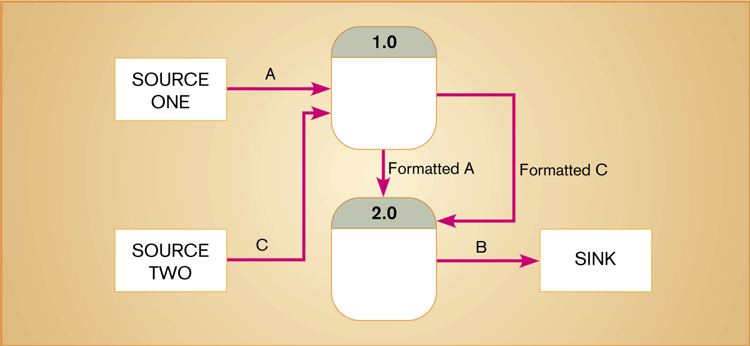
Figure 8-10
An unbalanced set of data flow diagrams—why?
(a) Context diagram (b) Level-0 diagram
8.<number>

Slide 23
Balancing DFDs
We can split a data flow into separate data flows on a lower level diagram (see Figure 8-11)
Balancing leads to four additional advanced rules (See Table 8-3)
8.<number>

Slide 24

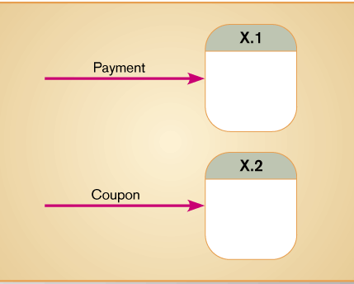
Data Flow Splits and Joins
Is this allowed?

